Slide 1

ACM REP ‘24

Slide 2
ACM REP ‘23

Slide 3
ACM REP ‘23
June 27-29, 2023 Santa Cruz, CA, USA

Slide 4
ACM REP ‘23

Slide 5
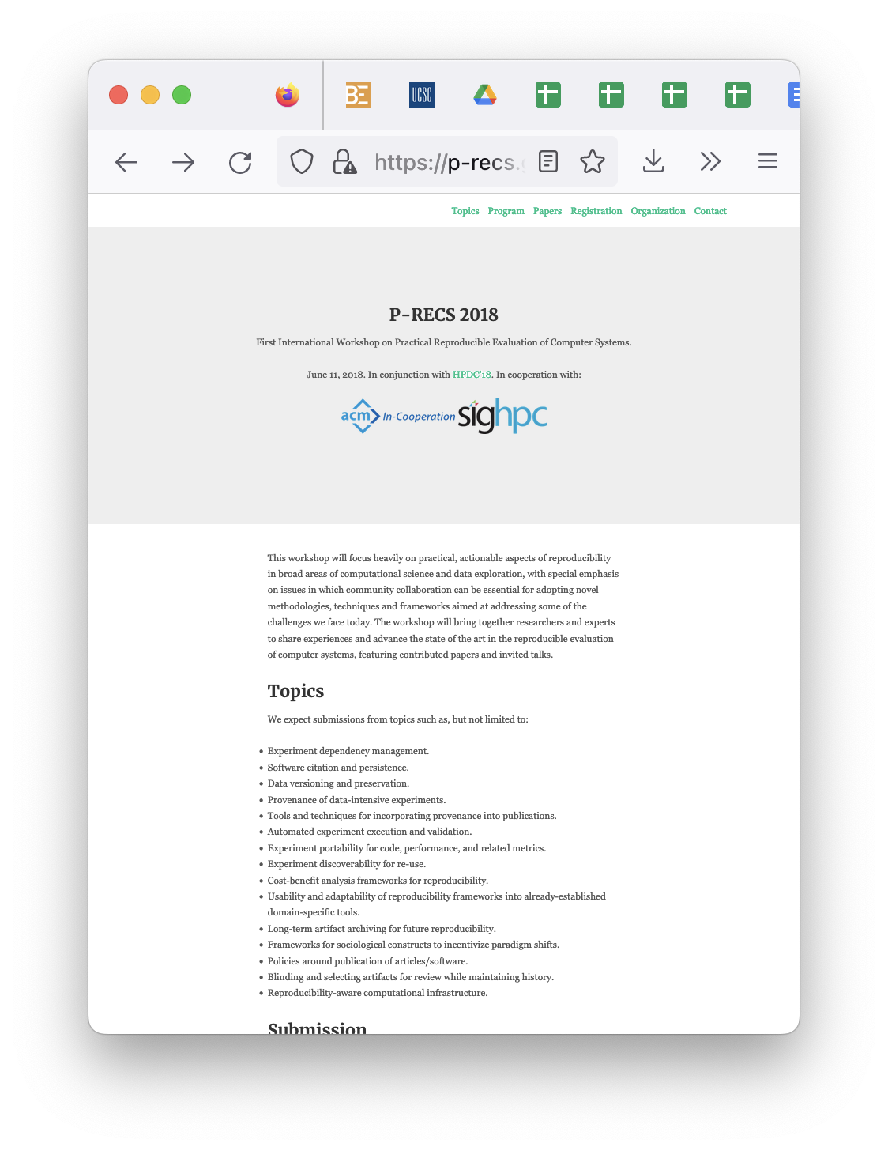
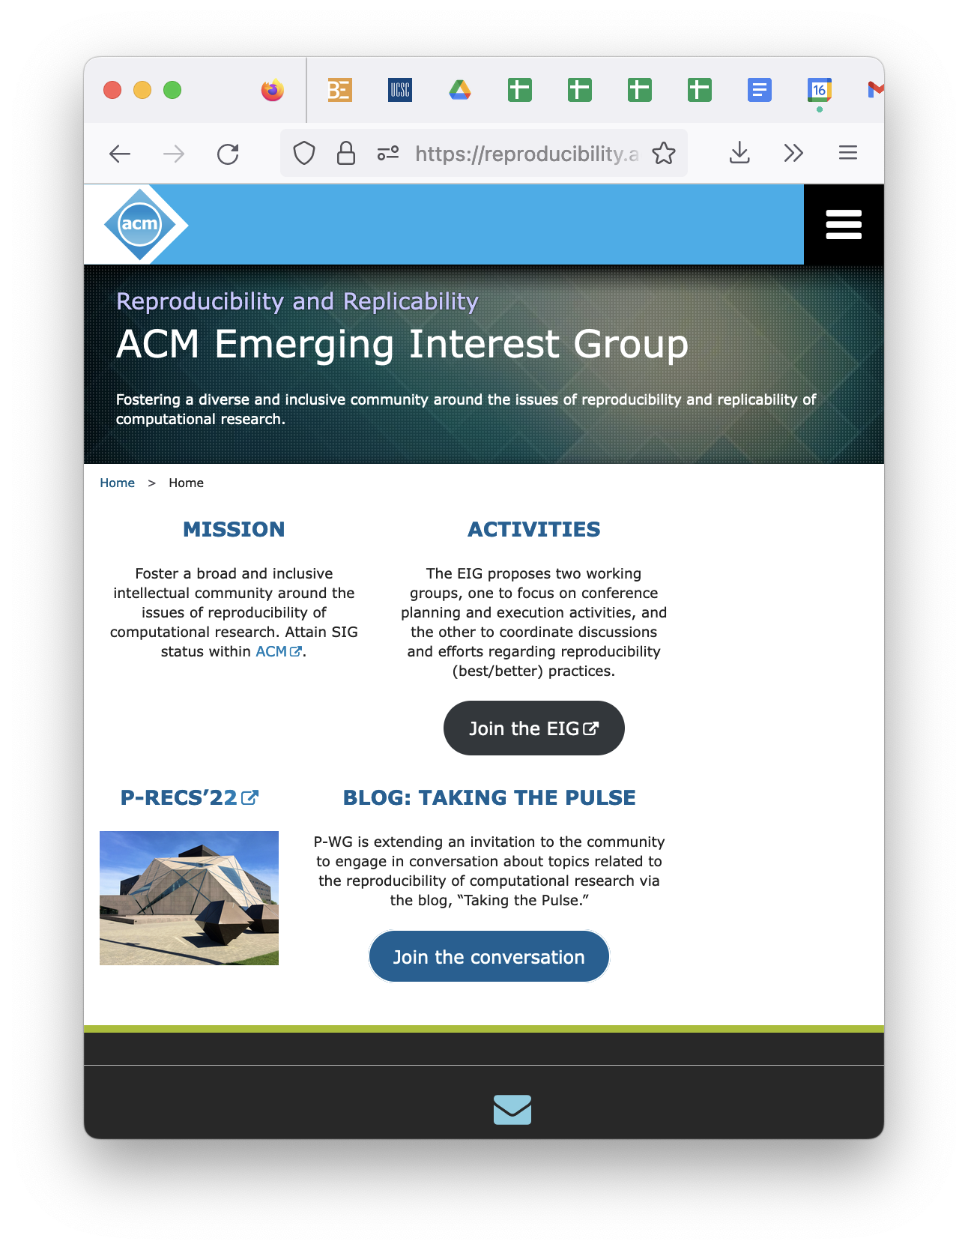

Slide 6

ACM REP ‘23

Slide 7

ACM REP ‘23

Slide 8

ACM REP
2024

Slide 9
ACM REP
2023

Slide 10
ACM REP
2023

Slide 11
ACM REP
2023

Slide 12
ACM REP
2023

Slide 13

ACM REP ‘23

